Slide 1
Weekly touchpoint #2
Henry Quillin
intern project

Slide 2
Progress

Slide 3
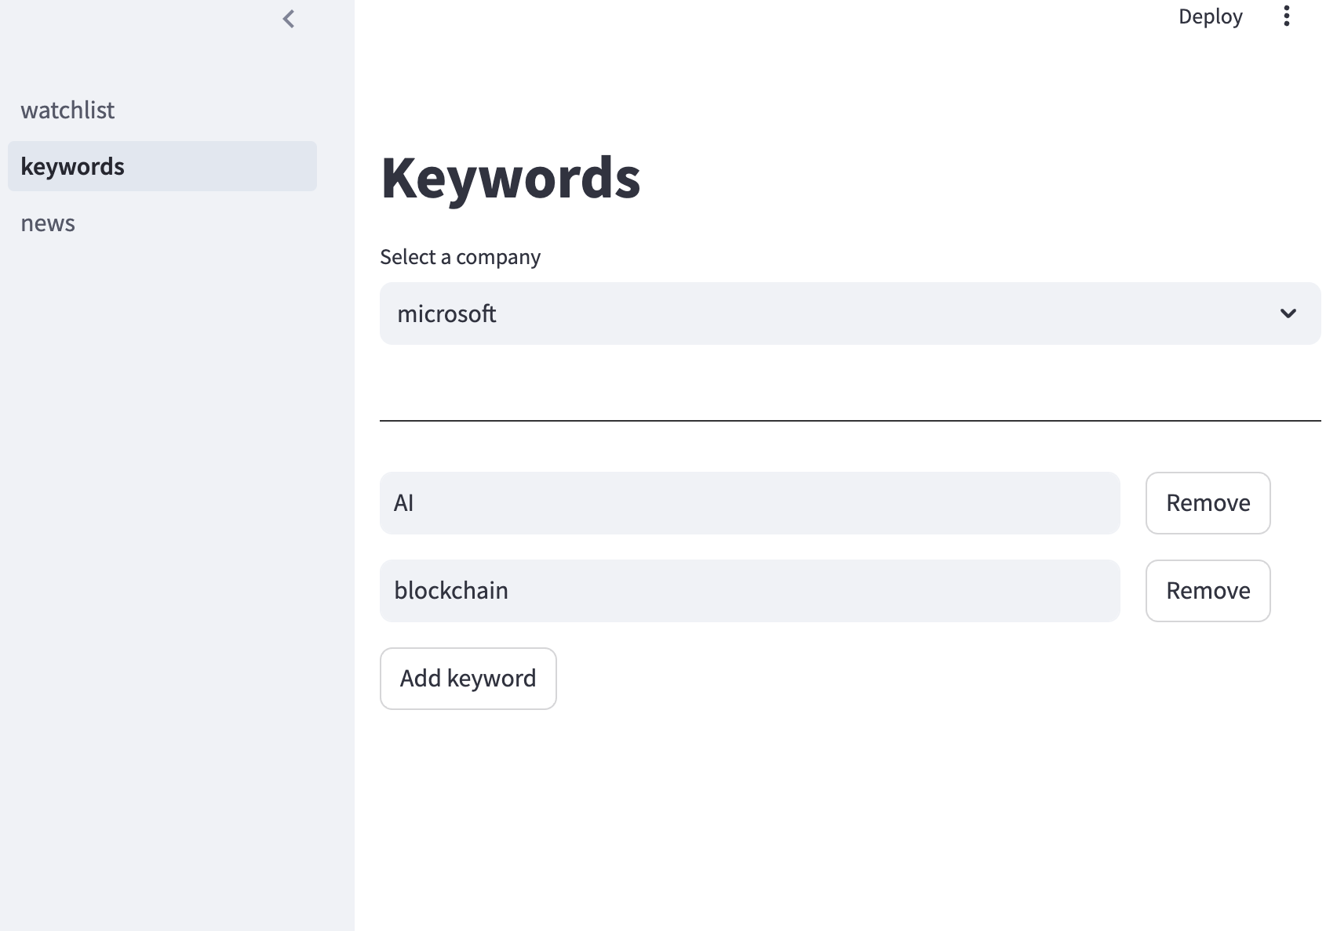
Keywords page
Users can edit existing keywords or add new keywords to the list
Each company has a different keyword list
If an article doesn’t contain any of the keywords on its keyword list, it will be filtered out of the news.
Keyword list is saved to the database

Slide 4
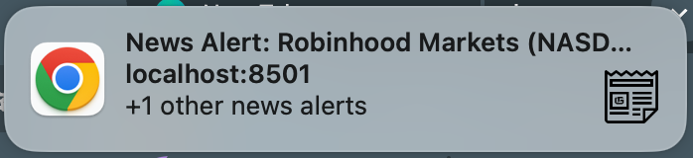
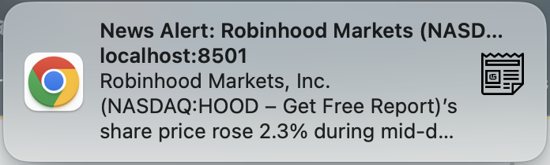
Browser Alerts
• The fetched news list is now on a separate page which can be accessed via the navigation panel.
• Next to the fetch button, there is a date start and date end input
• Any news that matches the query will be shown in a push notification and added to the fetched news list.
Multiple articles found
Single article found

Slide 5
Next Ticket’s Acceptance criteria

Slide 6
Article log page (SCATPK-803)
A new "Article Log" page is accessible from the navigation panel
All fetched news articles are displayed on this page
Articles are saved to the database upon fetching
The page displays key information for each article: title, source, date published, and companyAdd search and filtering to the article log
Option to filter by date published, source, company, etc…
Pagination

Slide 7
Add search and filtering to the article log
A search bar is present at the top of the Article Log page
Users can search articles by keyword in title or description
Filter options are available for:
Date published
Source
Company
Multiple filters can be applied simultaneously
Filtered results update in real-time as filters are applied
Pagination
Options to show 10, 25, or 50 articles per page
"Next" and "Previous" buttons are available for navigation between page
The current page number and total number of pages are displayed

Slide 8
Duplicate prevention
I’ll use a Python NLP library with a text similarity model to identify duplicate or near-duplicate articles
When duplicate articles are detected, they are grouped together under a single primary article
The primary article has a new field called "duplicates" which contains links to all detected duplicate articles
The "duplicates" field is visible on the article log page and can be expanded to show all duplicate articles
Duplicate articles are not shown as separate entries in the main article log, but are accessible through the primary article
The duplicate detection process runs automatically when new articles are fetched
The similarity threashold can be configured by the user

Slide 9
Individual article page
Clicking on an article in the Article Log opens a new page with full article details
The individual article page displays:
Full title
Author (if available)
Publication date and time
Source with link
Full description/content
Any associated images
A "duplicates" section if the article has any detected duplicates
In the "duplicates" section:
Each duplicate article is listed with its title, source, and publication date
Users can click on a duplicate to view its full content
The similarity score for each duplicate is displayed
The URL of this page is shareable and opens the same article when accessed directly

Slide 10
Feedback / questions

